Slide 1
HL7 Training for Immunization Information System Interface Specialists
Chicago Illinois – April 2013

Slide 2
Overview of IIS Standards

Slide 3
Immunization Standards
Health Level Seven
International Organization
Vaccination Updates
Vaccination Queries
CDC Implementation Guide
Produced with IIS community input
Basis for Meaningful Use stage 2 requirements for immunization reporting
Local IIS Guides
Further constrains CDC Implementation Guide

Slide 4
History of HL7
1987 – HL7 founded
Originally tasked with developing standards for hospital information systems
1989 - HL7 v2 standard released
1994 – Accredited by ANSI
1995 – HL7 v3 development began
1997 – HL7 2.3 released
1999 – HL7 2.3.1 released
2007 – HL7 2.5.1 released
2011 – HL7 2.7 released
2013 – Board announced intention of allowing free access to standards

Slide 5
HL7 v2 – Message vs. Transport
HL7 refers to 7th Layer of the ISO OSI model of network layers
HL7 was initially chartered to focus exclusively on message content
HL7 did not define or standardize the way message content was transmitted
A simple standard called the Minimal Lower Level Protocol (MLLP) was eventually designed and suggested for use with HL7 messages
MLLP is simple protocol for using TCP/IP to send HL7 messages, but does not itself define security
MLLP is still used extensively today in hospital networks

Slide 6
CDC Implementation Guide
Past and Current Releases
HL7 2.3.1 Guide original release - ?
HL7 2.3.1 Guide version 2.2 – June 2006
HL7 2.5.1 Guide version 1.4 – HL7 2.5.1
Change Process
Lead by IIS community
Standards originally managed by CIRSET, later merged into AIRA
Standards and Interoperability Steering Committee (SISC) directs and organizes current effort
Rob Savage is tasked by the Immunization Information Systems Support Branch (IISSB) of the CDC to edit and release changes to the guide in accordance with the consensus of the IIS community

Slide 7
CDC Implementation Guide
Next Release 1.5
Changes being discussed now
Currently discussing issues around:
Items that were identified in NIST certification that need more clarification and standardization
Areas that need more standardization to support certification of query messages, possibly to be adopted in Meaningful Use stage 3 recommendations
Clarification and standardization in areas identified by the IIS Interoperabilty Status Check
Other items identified by SISC

Slide 8
Local Immunization Guides
Each IIS may further constrain the CDC Implementation Guide
Require fields that are optional
Require segments that are optional
Make additional business layer constraints, such as not accepting adult records or not accepting SSN’s.
IIS should not:
Require the sender to not populate a required field or required but may be empty field
Make a requirement that contradicts either the national or international HL7 standard

Slide 9
Resources Provided by IISSB
http://www.cdc.gov/vaccines/programs/iis/technical-guidance/index.html

Slide 10
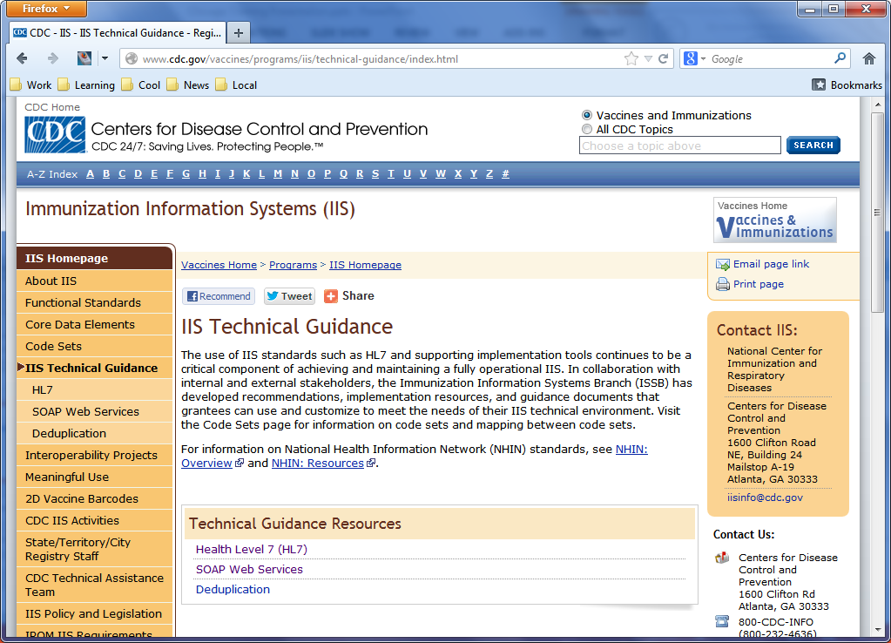

Slide 11
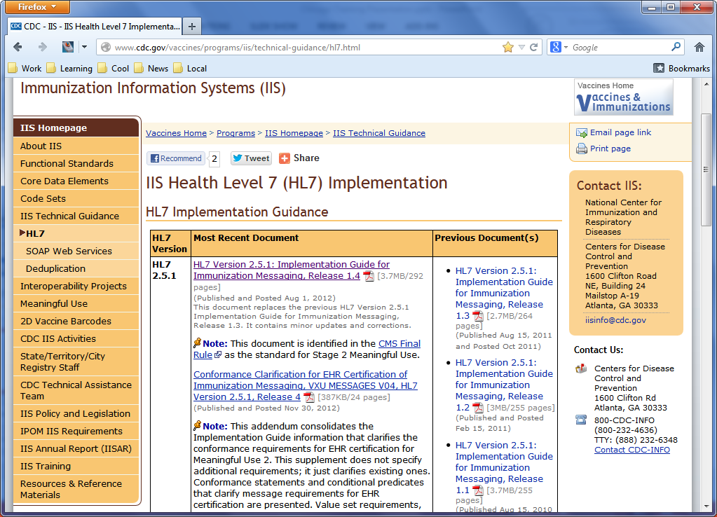

Slide 12
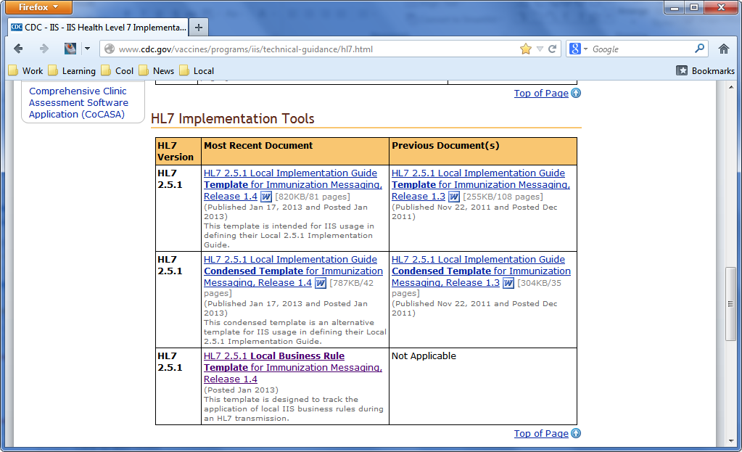

Slide 13
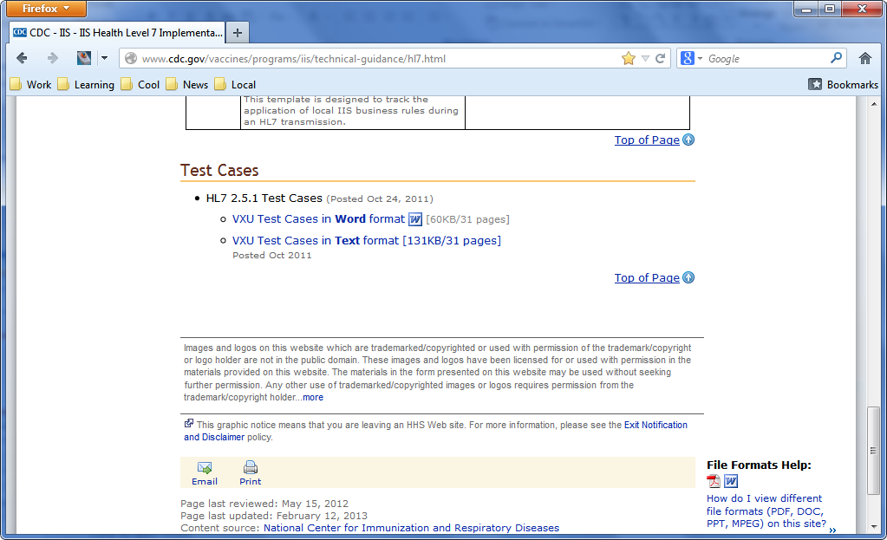

Slide 14
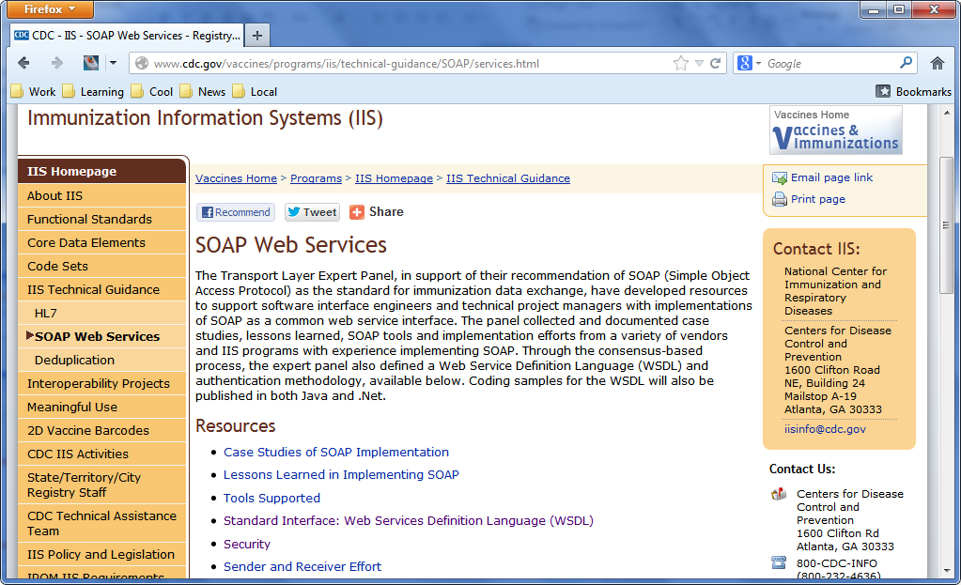

Slide 15
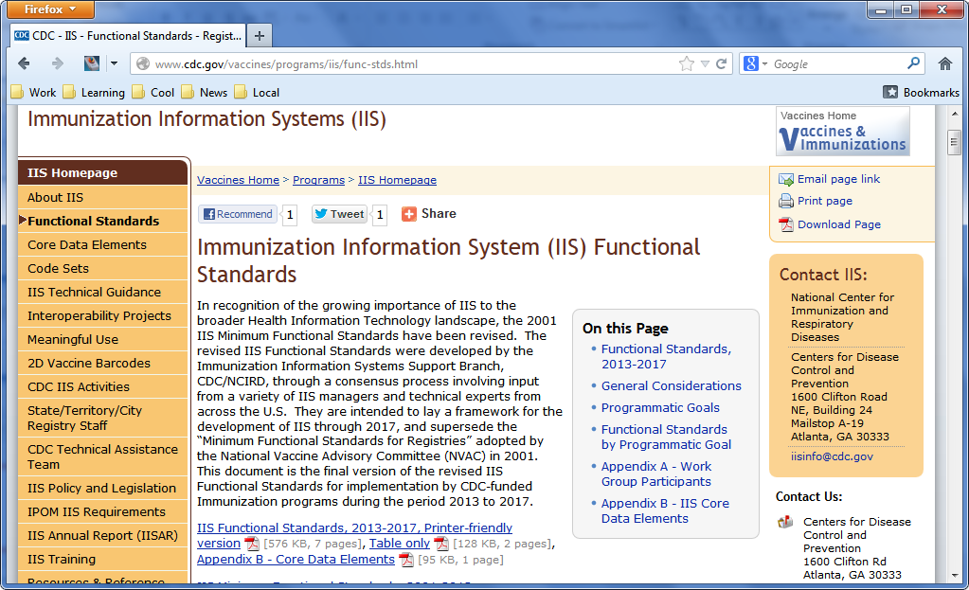

Slide 16
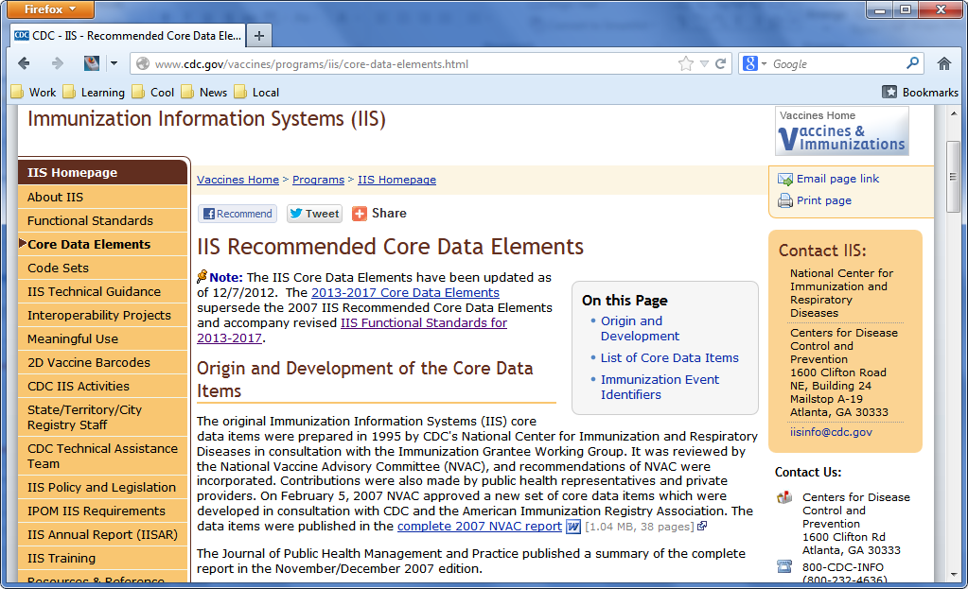

Slide 17
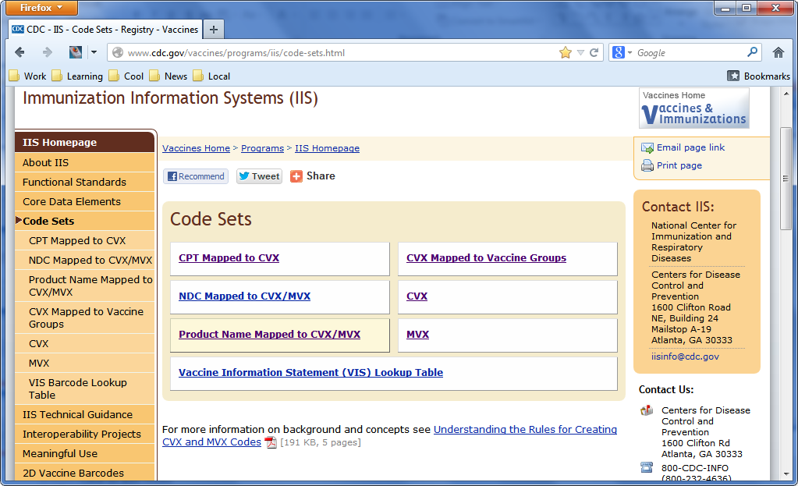

Slide 18
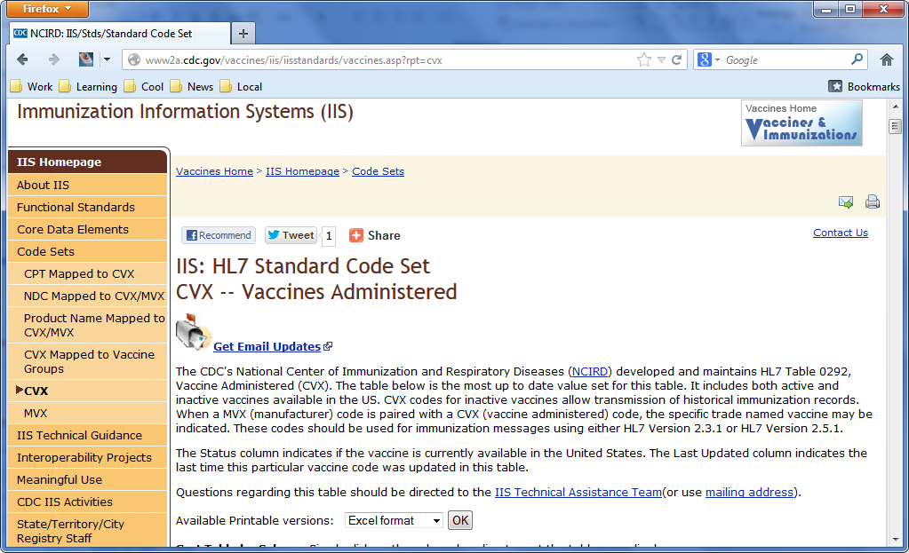

Slide 19
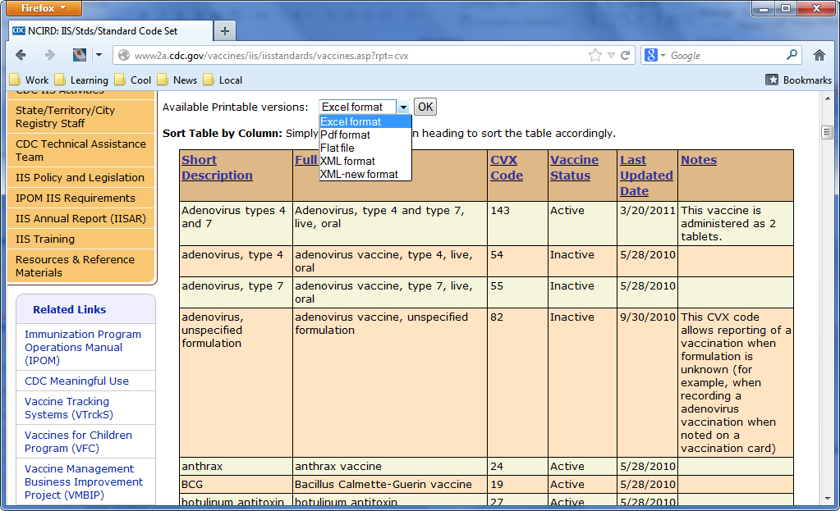

Slide 20
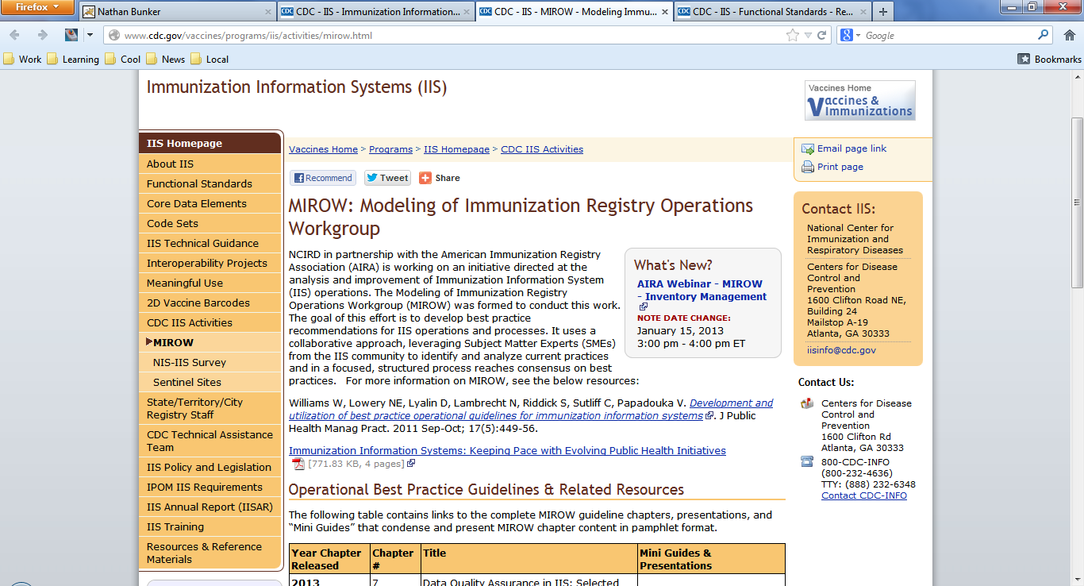

Slide 21
Meaningful Use and NIST Certification
Meaningful Use Regulation
Program to pay providers who purchase and implement an Electronic Health Record (EHR) system
Provider must not only purchase the EHR but must demonstrate that the software was put to use in a meaningful way
Submitting immunization records to a local IIS was identified as a core use of an EHR and in MU version 2 providers will have to demonstrate regular submission to their local IIS
NIST Certification
Providers must purchase an EHR that has been certified to meet MU standards.
NIST is responsible for creating the test or process for EHR systems to be certified

Slide 22
NIST Certification
NIST Certification Process was developed
CDC Implementation Guide version 1.4 was identified by Meaningful Use version 2 to define the standard for EHR submission to IIS
Rob Savage and Nathan Bunker worked directly with the NIST team as they developed NIST certification process
NIST Certification greatly improved
NIST certification for MU stage 1 was minimal and based only off the HL7 international standards
NIST certification for MU stage 2 is greatly improved and requires EHR systems to support standard US vaccine programs

Slide 23
Transport Layer Expert Panel (TLEP)
Convened in 2011 to decide on a common transport method
Four technologies considered
HTTPS POST
PHIN-MS
Web Services
Direct
Web Services choosen

Slide 24
Transport Standards Currently Used by IIS
SFTP/FTPS
Manual upload of HL7 file directly into IIS
HTTPS Post
Web Services
PHIN-MS

Slide 25
Other standards you may hear about
HL7 v3 – Standard built off a universal model for health care data
HL7 FHIR – New standard being developed, definitely on the frontier
IHE – Integrating the Health Care Enterprise
LOINC – codes for identifying medical laboratory observations
SNOMED – standard for codifying medical terms

Slide 26
Diving into HL7 v2 Messages

Slide 27
Recipe for an HL7 Message
Remember:
HL7 was designed before the common use of HTML, XML and other modern data formats
Example Data
Mickey Mouse born 11/03/2001
Assigned 101 as a medical record number by EHR
Lives at 123 Main Street, Anaheim, CA 92189
Has two vaccinations on his record:
MMR given 04/10/2013
Hep B given 11/03/20001

Slide 28
Example Evolution of HL7 Standard
Change #1: Use | to separate data fields
101|Mouse, Mickey|11/03/2001|123 E Main St, Anaheim, CA 92189|04/10/2013|MMR, CVX 03|11/03/2011|Hep B, CVX 08|
Change #2: Encode dates using a simple format: YYYYMMDD
101|Mouse, Mickey|20010311|123 E Main St, Anaheim, CA 92189|20130410|MMR, CVX 03|20111103|Hep B, CVX 08|
Change #3: Group similar fields into data types, separate with ^
101|Mouse^Mickey|20011030|123 E Main St^^Anaheim^CA^92189|20130410| 03^MMR^CVX|20111103|08^Hep B^CVX|

Slide 29
Example Evolution of HL7 Standard
Change #4: Place similar kinds of fields together in a segment, place each segment on it’s own line, and begin each segment with a segment name. This gives the following benefits:
Segments can be reused
Segments can then repeat
PID|101|Mouse^Mickey|20011030|123 E Main St^^Anaheim^CA^92189|
RXA|20130410|03^MMR^CVX|
RXA|20111103|08^Hep B^CVX|

Slide 30
Example Evolution of HL7 Standard
Change #5: Need to track information about what kind of message this is, where it’s coming from, and other information.
Add a Message Header segment
Have it indicate the type of message and the time it was created
MSH|20130410155900|VXU|
PID|101|Mouse^Mickey|20011030|123 E Main St^^Anaheim^CA^92189|
RXA|20130410|03^MMR^CVX|
RXA|20111103|08^Hep B^CVX|

Slide 31
Example Evolution of HL7 Standard
Change #6: Patient might have more than one address, how do we message that?
Allow some fields to repeat
Use ~ character to separate repeated fields
MSH|20130410155900|VXU|
PID|101|Mouse^Mickey|20011030|123 E Main St^^Anaheim^CA^92189~PO Box 2179^^Anaheim^CA^92189-2179|
RXA|20130410|03^MMR^CVX|
RXA|20111103|08^Hep B^CVX|

Slide 32
Example Evolution of HL7 Standard
Change #7: What if a field component needs to be further sub-divided?
Use & character
This is rarely if ever done in immunization messages
Showing an example of how Mickey’s name might look if he needed to move to France “Mickey le Mouse”
MSH|20130410155900|VXU|
PID|101|Mouse&le^Mickey|20011030|123 E Main St^^Anaheim^CA^92189|
RXA|20130410|03^MMR^CVX|
RXA|20111103|08^Hep B^CVX|

Slide 33
Example Evolution of HL7 Standard
Change #8: What if one of the special characters |, ^ or & needs to be sent in a message?
Use a special character \ to escape
Warning! HL7 implements escaping very differently from other standards
Mickey has moved to a new address listed simply as “Main & Fourth”.
The & can not be sent as is, replace with \T\
MSH|20130410155900|VXU|
PID|101|Mouse^Mickey|20011030|Main \T\ Fourth^^Anaheim^CA^92189|
RXA|20130410|03^MMR^CVX|
RXA|20111103|08^Hep B^CVX|

Slide 34
Example Evolution of HL7 Standard
Change #9: Some systems don’t like to substitute characters, can’t they just change the separator character?
Change standard to separator characters are defined in each message
Place separator characters in the first fields of the MSH so the receiver knows which are being used.
MSH|^~\&|20130410155900|VXU|
PID|101|Mouse^Mickey|20011030|Main \T\ Fourth^^Anaheim^CA^92189|
OR
MSH|^~\*|20130410155900|VXU|
PID|101|Mouse^Mickey|20011030|Main & Fourth^^Anaheim^CA^92189|

Slide 35
Reading the Final Message
For most segments, the first field is in position 1, which means the value for field #1 in the PID segment is ‘1’
For MSH, the first bar is considered field #1, the four separator characters are together field #2, field #3 starts after the second bar is passed
MSH|^~\&|Test EHR Application|X68||NIST Test Iz Reg|201207010822||VXU^V04^VXU_V04|NIST-IZ-019.00|P|2.5.1|||AL|ER
PID|1||Q-73221^^^NIST MPI^MR||Mercer^Jirra^Emmanuelle^^^^L||20100907|F
ORC|RE||IZ-783278^NDA|||||||||57422^RADON^NICHOLAS^^^^^^NDA^L
RXA|0|1|20120816||141^Influenza^CVX|0.25|mL^milliliters^UCUM||00^New immunization record^NIP001||||||K5094SC|20121216|SKB^GlaxoSmithKline^MVX|||CP|A
RXR|IM^Intramuscular^HL70162|RA^Right Arm^HL70163

Slide 36
Introductions

Slide 37
Quality Assurance or Development?
For the purposes of today’s training everyone must identify themselves as belonging to one of these two groups:
Quality Assurance – Concerned primarily with insuring that the IIS interface works according to specifications
Development – Concerned primarily with creating an IIS interface that works according to specifications
Quality Assurance
Brian Moore
Cheryl Oliver-Knight
Eric Dansby
Eric Frederickson
Fran Johnston
James Wasa
Rand Tilton
Rashid Malik
Development
Angel Aponte
Caleb Shoemaker
Christina Voyles
Igor Slobodyanyuk
Kabita Joshi
Michael Powell
Rami Abuhamdeh
Steve Jarvis
Not Sure
Lisa Erickson
Sashidhar Kuppa
Kevin Samuelson

Slide 38
Answer These Question on Paper
What is your Name?
If you could go anywhere in the world this weekend, where would you go?

Slide 39
Please Tell the Group
What is your name?
Which group are you in quality assurance or development?
Which IIS you work with?
Why did you pick the career you currently have, or how did you end up working in a position that resulted in you being here today?
What is your name again?
Thanks!

Slide 40
IIS Interoperability Status Check

Slide 41
Methodology & Process
Engaged IIS to participate in project
Asked IIS to provide test system access or to perform self check
If access to IIS test system was granted the team:
Submitted the 7 NIST test messages, one at time, making changes to the messages until they were accepted by the IIS
If the IIS performed the self check they were given a document that asked them to submit the 7 NIST test messages and record the results
The results were reviewed by the status check team and recommendations and information was returned to each IIS

Slide 42
Status Check Participation
WA
MT
ND
ME
OR
MN
VT
NH
MA
ID
SD
WI
NY
WY
MI
NYC
CT
RI
IA
PA
PHIL
NJ
NV
NE
OH
RIDE
UT
IL
IN
DC
DE
CO
WV
VA
MD
CA
KS
MO
KY
TN
NC
SDIR
IM
AZ
OK
AR
SC
NM
MS
AL
GA
PR
TX
Guam
LA
American
Samoa
SA
FL
AK
WILLING
HI
PARTICIPATED

Slide 43
Issues that implementers of IIS HL7 interfaces should consider
Coded Values
Certain data related codes should not be hard-coded, IIS should be able to change these, or have them changed relatively quickly
Older code sets should be supported along with newer code sets to allow graceful adoption of new standards
Unrecognized values should not automatically indicate a message should be rejected
Code Table Names
These are being better standardized but in the past some fields did not define the name of the code table very specifically
Allow for use of alternate code table names that have been common used in the past
Consider generating warnings instead of rejecting a message when non-critical table names are not recognized

Slide 44
Issues that implementers of IIS HL7 interfaces should consider
Refusals
All IIS interfaces need to watch for refusals and be sure to either consume the data (ideal) or ignore it
CVX 998
All IIS interfaces should recognize the CVX 998 code and either consume the data in the associated OBX or ignore it
OBX Segments
OBX can be used to send all sorts of data
If the data being sent in a particular OBX is not recognized, it should be ignored
Generating warning when OBX data is ignored is appropriate

Slide 45
Areas that need further discussion in the IIS community
ACK Messages
Large amount of variability in ACK messages returned
A large subset of IIS are not following HL7 standards
SISC will be clarifying the use of ACK messages
Sending System Identification
Authentication and identification of the sending system is highly variable
Many good solutions to the same problem
Standardization currently under consideration
MSH-11 Processing ID
IIS interpret this field differently

Slide 46
Areas that need further discussion in the IIS community
PID-3
The sending systems medical record number or patient id does not have a standard encoding yet most (or all) IIS require and depend on this specific id
PD1-13 Patient Primary Facility
Currently an optional field, is required by some IIS.
MSH-12 Version Id
Some IIS require a specific value while others allow older or newer versions to be submitted
HL7 allows for backwards and forwards submission
Perhaps CDC Implementation Guide specifically recommend interfaces allow older or newer versions under the current version

Slide 47
Areas that need further discussion in the IIS community
IN1 & IN2 segments
One IIS requires insurance information, others may require it in the future
May want to define segments in more detail in the guide
MSH-6
Some IIS require a specific value, set by the IIS here
Perhaps NIST certification needs to verify that EHR can set this value
SSN
One IIS does not allow EHR’s to send this
Perhaps guide should indicate that this field may need to be blocked for some IIS
Consent
Some IIS require consent for only their adult or child records
Perhaps language about this variability should be in the guide

Slide 48
Training Exercise

Slide 49
Training Exercise
Everyone will divide into teams of two people
There will be both quality assurance and development teams
Each development team will create a software process that reads an HL7 message and creates an acknowledgement message
The quality assurance teams will create a testing process to verify the work of the development team
At 4:00 pm today each quality assurance team will be matched with a development team to test the newly created software process

Slide 50
Requirement #1: Accept 3 VXU Messages
Software process must be able to process three selected NIST test messages:
VXU with 1 historical and 2 administered vaccinations.
VXU with a parental refusal
VXU with a history of varicella disease reported

Slide 51
Message #1
MSH|^~\&|Test EHR Application|X68||NIST Test Iz Reg|201207010822||VXU^V04^VXU_V04|NIST-IZ-019.00|P|2.5.1|||AL|ER
PID|1||Q-73221^^^NIST MPI^MR||Mercer^Jirra^Emmanuelle^^^^L||20100907|F
ORC|RE||IZ-783278^NDA|||||||||57422^RADON^NICHOLAS^^^^^^NDA^L
RXA|0|1|20120816||141^Influenza^CVX|0.25|mL^milliliters^UCUM||00^New immunization record^NIP001||||||K5094SC|20121216|SKB^GlaxoSmithKline^MVX|||CP|A
RXR|IM^Intramuscular^HL70162|RA^Right Arm^HL70163
OBX|1|CE|64994-7^Vaccine funding program eligibility category^LN|1|V05^VFC eligible - Federally Qualified Health Center Patient (under-insured)^HL70064||||||F|||20120701|||VXC40^Eligibility captured at the immunization level^CDCPHINVS
OBX|2|CE|30956-7^vaccine type^LN|2|88^Influenza, unspecified formulation^CVX||||||F
OBX|3|TS|29768-9^Date vaccine information statement published^LN|2|20120702||||||F
OBX|4|TS|29769-7^Date vaccine information statement presented^LN|2|20120814||||||F
ORC|RE||IZ-783281^NDA|||||||||57422^RADON^NICHOLAS^^^^^^NDA^L
RXA|0|1|20110216||10^IPV^CVX|999|||01^Historical information - source unspecified^NIP001
ORC|RE||IZ-783282^NDA|||||||||57422^RADON^NICHOLAS^^^^^^NDA^L
RXA|0|1|20120816||120^DTaP-Hib-IPV^CVX|0.5|mL^milliliters^UCUM||00^New immunization record^NIP001||||||568AHK11|20121216|PMC^sanofi pasteur^MVX|||CP|A
RXR|IM^Intramuscular^HL70162|RA^Right Arm^HL70163
OBX|1|CE|64994-7^Vaccine funding program eligibility category^LN|1|V05^VFC eligible - Federally Qualified Health Center Patient (under-insured)^HL70064||||||F|||20120701|||VXC40^Eligibility captured at the immunization level^CDCPHINVS
OBX|2|CE|30956-7^vaccine type^LN|2|107^DTaP^CVX||||||F

Slide 52
Message #2
MSH|^~\&|Test EHR Application|X68||NIST Test Iz Reg|201207010822||VXU^V04^VXU_V04|NIST-IZ-013.00|P|2.5.1|||AL|ER
PID|1||MR-67323^^^NIST MPI^MR||Fleming^Chad^^^^^L||20100830|M
ORC|RE||9999^CDC
RXA|0|1|20120815||03^MMR^CVX|999||||||||||||00^Parental Refusal^NIP002||RE

Slide 53
Message #3
MSH|^~\&|Test EHR Application|X68||NIST Test Iz Reg|201207010822||VXU^V04^VXU_V04|NIST-IZ-016.00|P|2.5.1|||AL|ER
PID|1||MR-11891^^^NIST MPI^MR||Wolfe^Aron^^^^^L||20010907|M
ORC|RE||9999^CDC
RXA|0|1|20110215||998^No vaccine administered^CVX|999||||||||||||||NA
OBX|1|CE|59784-9^Disease with presumed immunity^LN|1|38907003^Varicella infection^SCT||||||F

Slide 54
Requirement #2: Verify Contents
The software process must be able to read the contents of the submitted message and identify 30 different types of issues
Some of these issues are configurable and the software process should be able to either identify the issue as a warning or an error
Some of the coded values should also be configurable, during testing the quality assurance team may ask the software process to accept properly a new coded value

Slide 55
Issues to Recognize

Slide 58
Requirement #3: Generate ACK Message
Functionality of the software process will be demonstrated by identifying and reporting the issues properly in an HL7 ACK message
The ACK message must:
Definitively indicate whether the message was accepted or not
Should indicate all issues found in the message, not just the first one encountered
Should conform to HL7 2.5.1 standards and the CDC Implementation Guide

Slide 59
Application Interface
Ideally the interface would be:
A simple web page with a single text box for submitting the message
A simple TLEP web interface for taking the message and replying back with ACK
Or good enough for today’s exercise
A user interface, such as a web page or application dialog box, that accepts the message and returns an ACK
A command line program that takes the message in and returns an ACK

Slide 60
Choice of Technology
Here are the preferred technologies (in no particular order)
.NET/ASP/VB
Java
PHP
JavaScript
Must be:
Very well understood by development team
Does not require learning new tools or programming paradigms
Final solution will be easy to follow for average developer familiar with that technology

Slide 61
Coding Style
Focus on writing code that:
Has lots of comments indicating what your team was thinking
Organized so that it will be easy for others to follow what you were doing
Prefer standardized, well known methods, over others that may be less understood
Prioritize creating clear code over creating an efficient solution

Slide 62
Quality Assurance
Each team will need to make a plan that is:
Compact and succinct as possible
Addresses all 30 tests
Try to test as many issues in a single message as is feasible
Verification of Test Cases
Test cases should be verify as correct (beyond the issues that are being tested) by the NIST “context-free validation” tool
If there is time:
Give recommendations on what items should be included in a basic HL7 interface quality assurance testing plan

Slide 63
Results From Training
Quality Assurance Teams
Can create a test plan
Understand what needs to be included in a good test plan
Development Teams
Understand the basics of making a compliant HL7 interface
Understand how to create software that is testable
Testing Resources
Example test plans for other IIS
Example code for developers

